Slide 1

A5a: Low-Fi Prototype
Group Number: 5
Group Name: Cool Health Guides
Group Members: CHEN, Yuxin (Katy)

Slide 2

Optional Daily Journaling Scenario
“You are a 3rd-year management student. You heard from your friends there is a
website that could help you better understand your mental health situation, and
you decided to try it.”

Slide 3
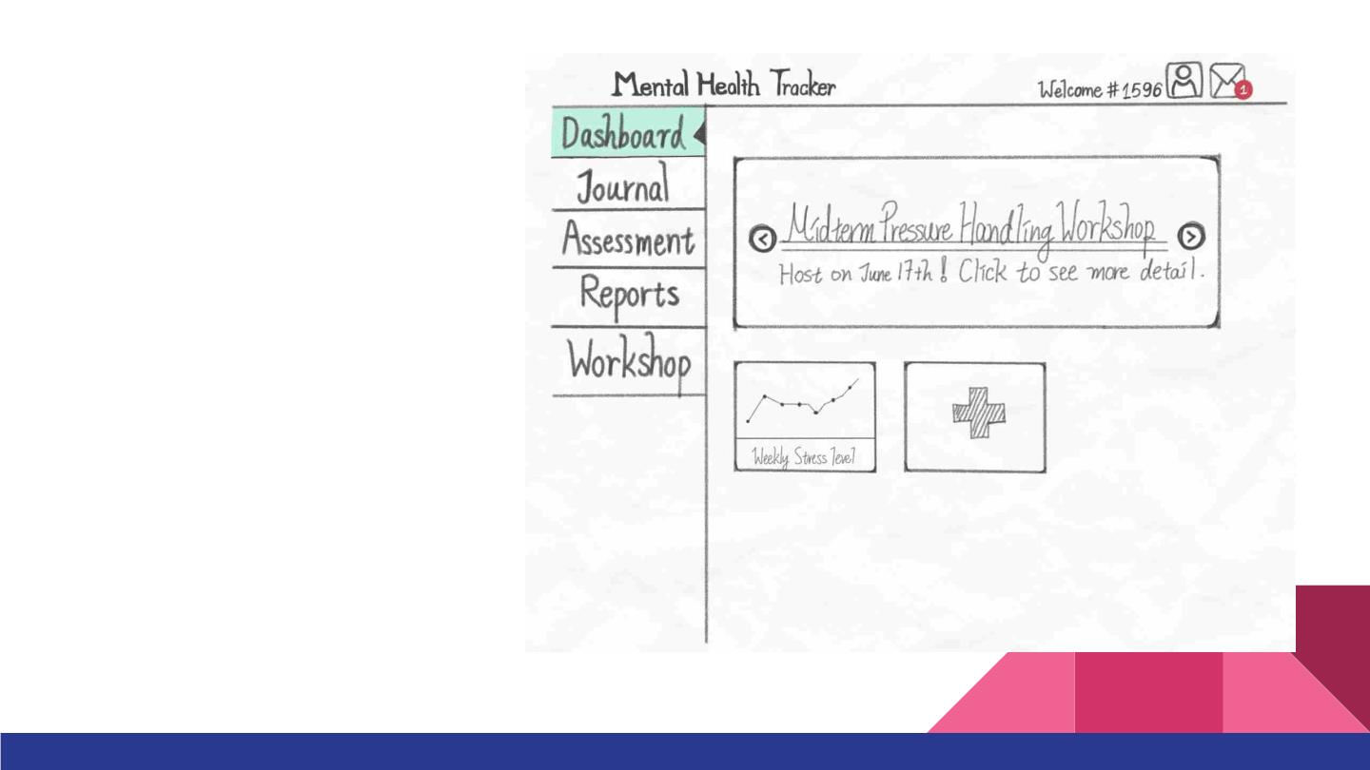
1. You want to record your
exult mood, and you also
want to record the sunny
and cloudy weather. How
would you complete it
using this prototype?

Slide 4
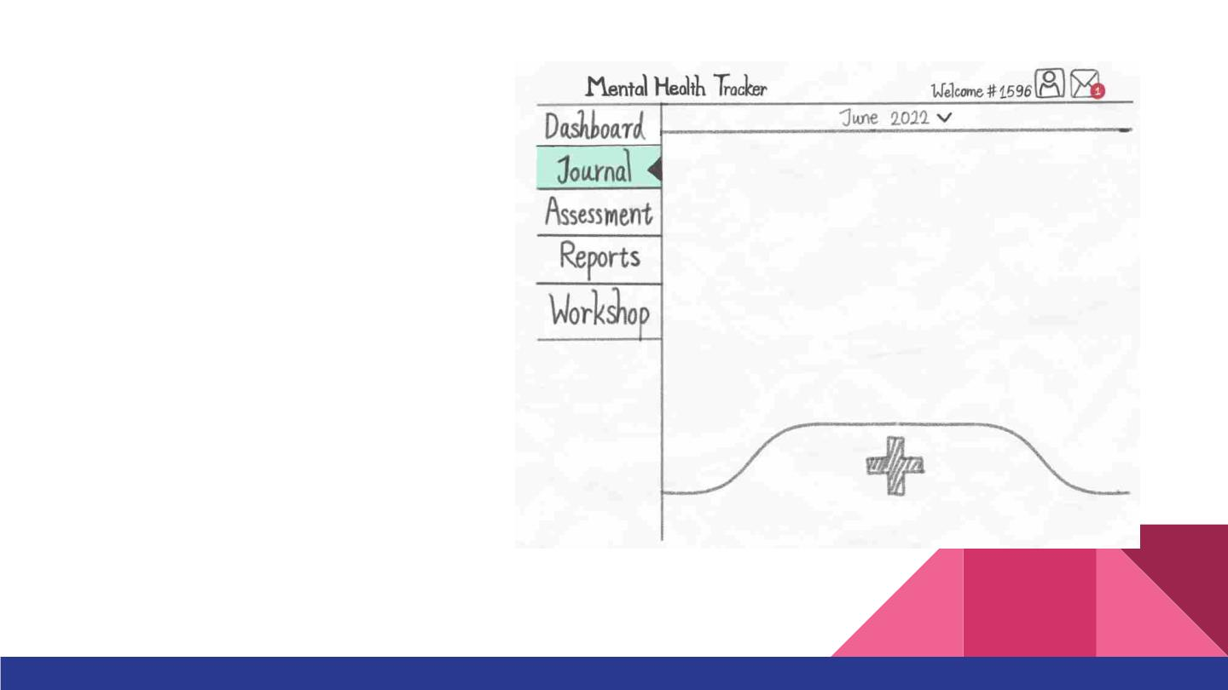
1. You want record your
exult mood, and you also
want to record the sunny
and cloudy weather. How
would you complete it
using this prototype?

Slide 5
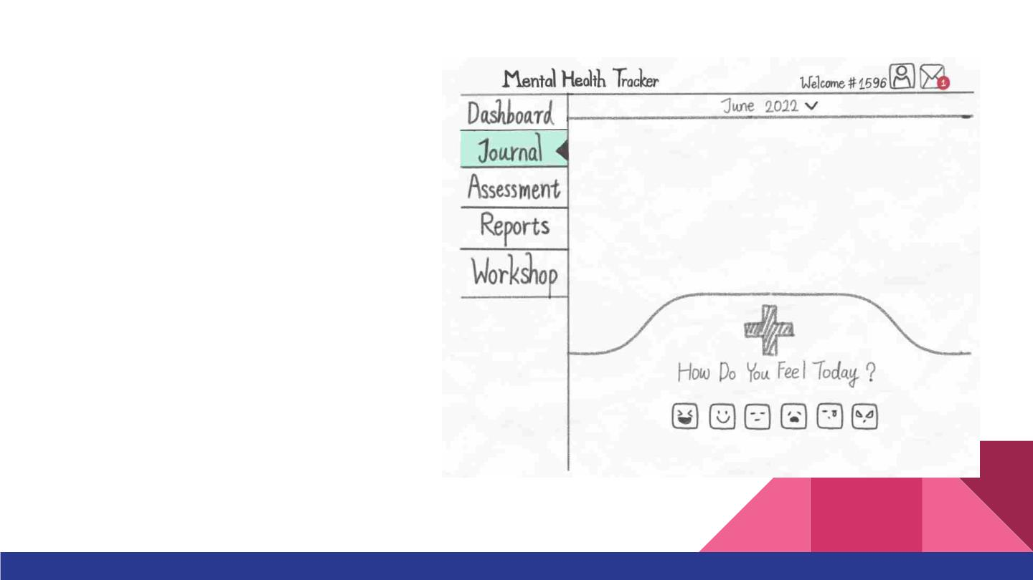
1. You want to record your
exult mood, and you also
want to record the sunny
and cloudy weather. How
would you complete it
using this prototype?

Slide 6
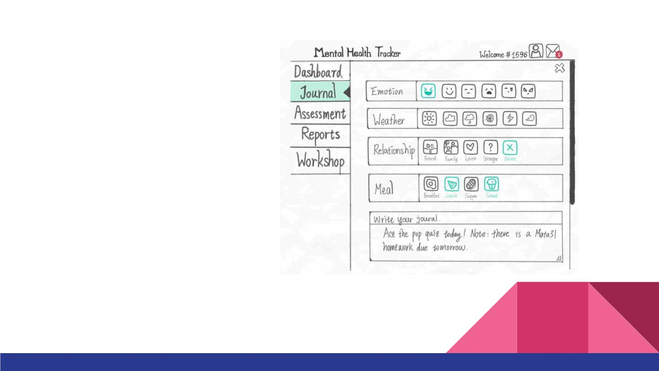
1. You want to record your
exult mood, and you also
want to record the sunny
and cloudy weather. How
would you complete it
using this prototype?

Slide 7
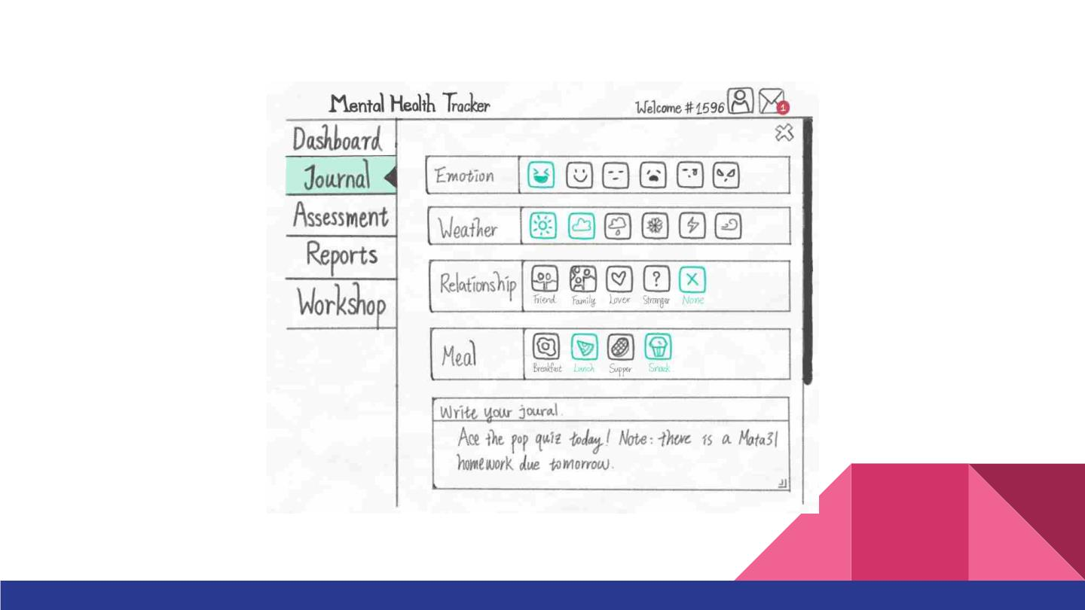

Slide 8
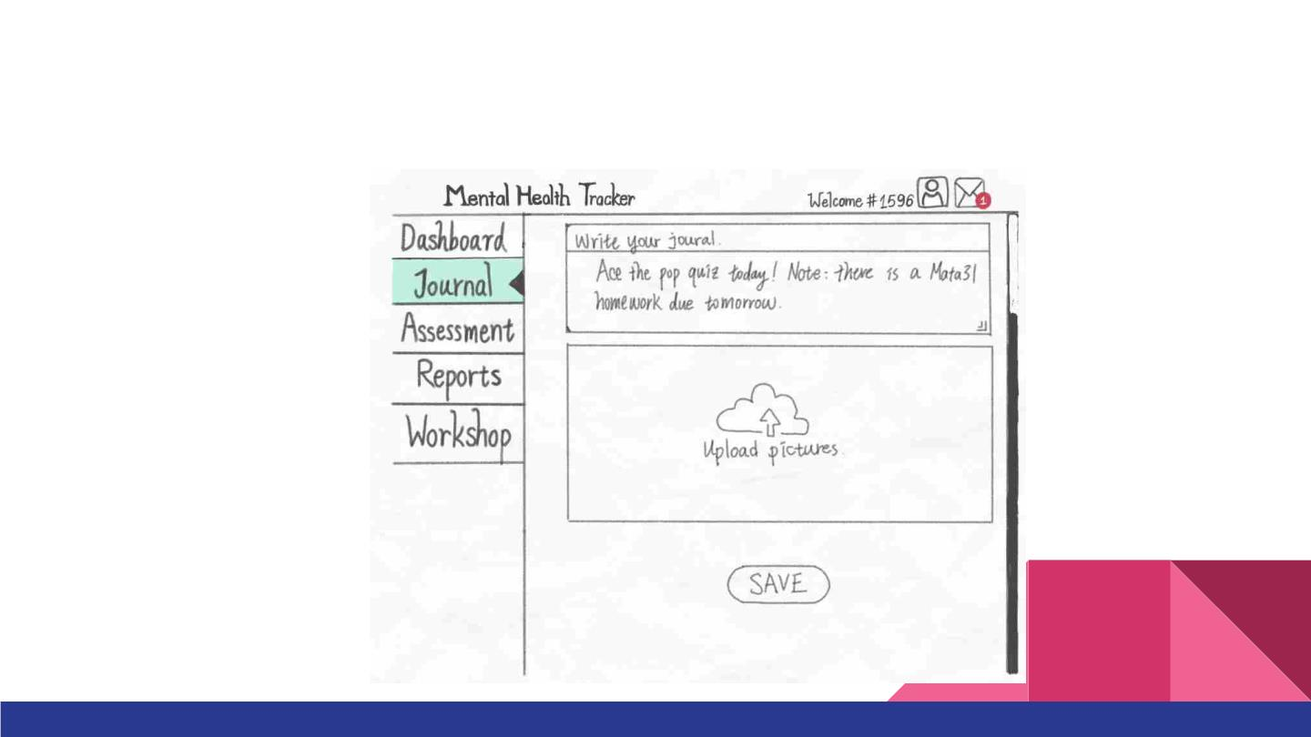
2. You reviewed your journal and are pretty satisfied with it. Hence, you want to keep
it. How would you do it using the prototype?

Slide 9
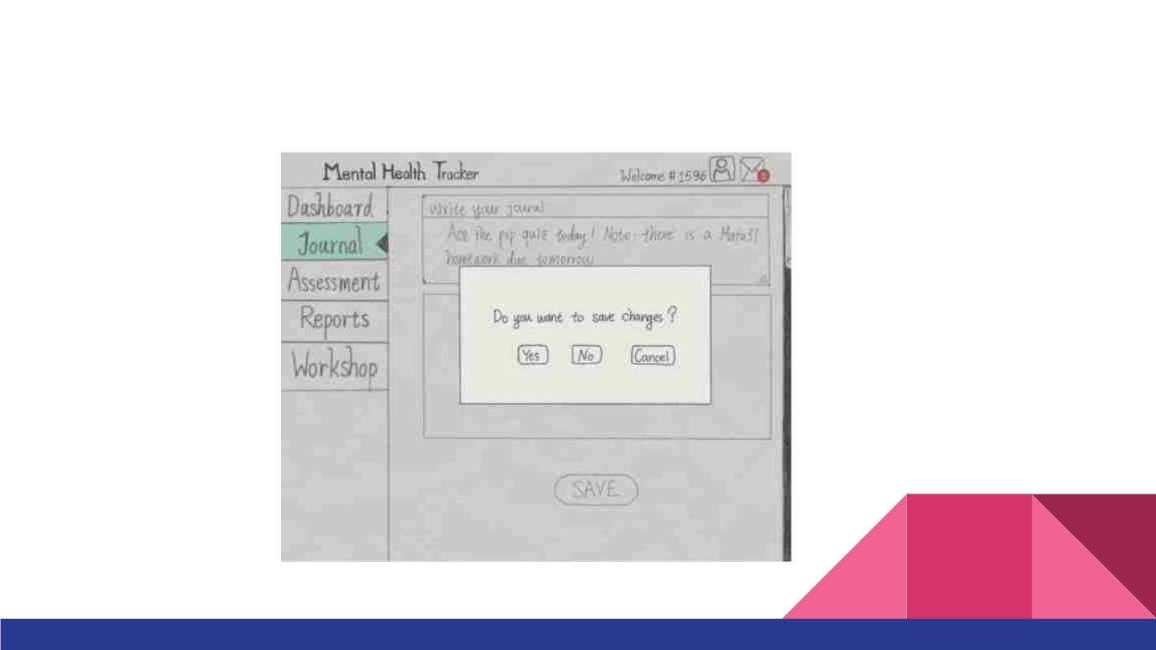
2. You reviewed your journal and are pretty satisfied with it. Hence, you want to keep
it. How would you do it using the prototype?

Slide 10
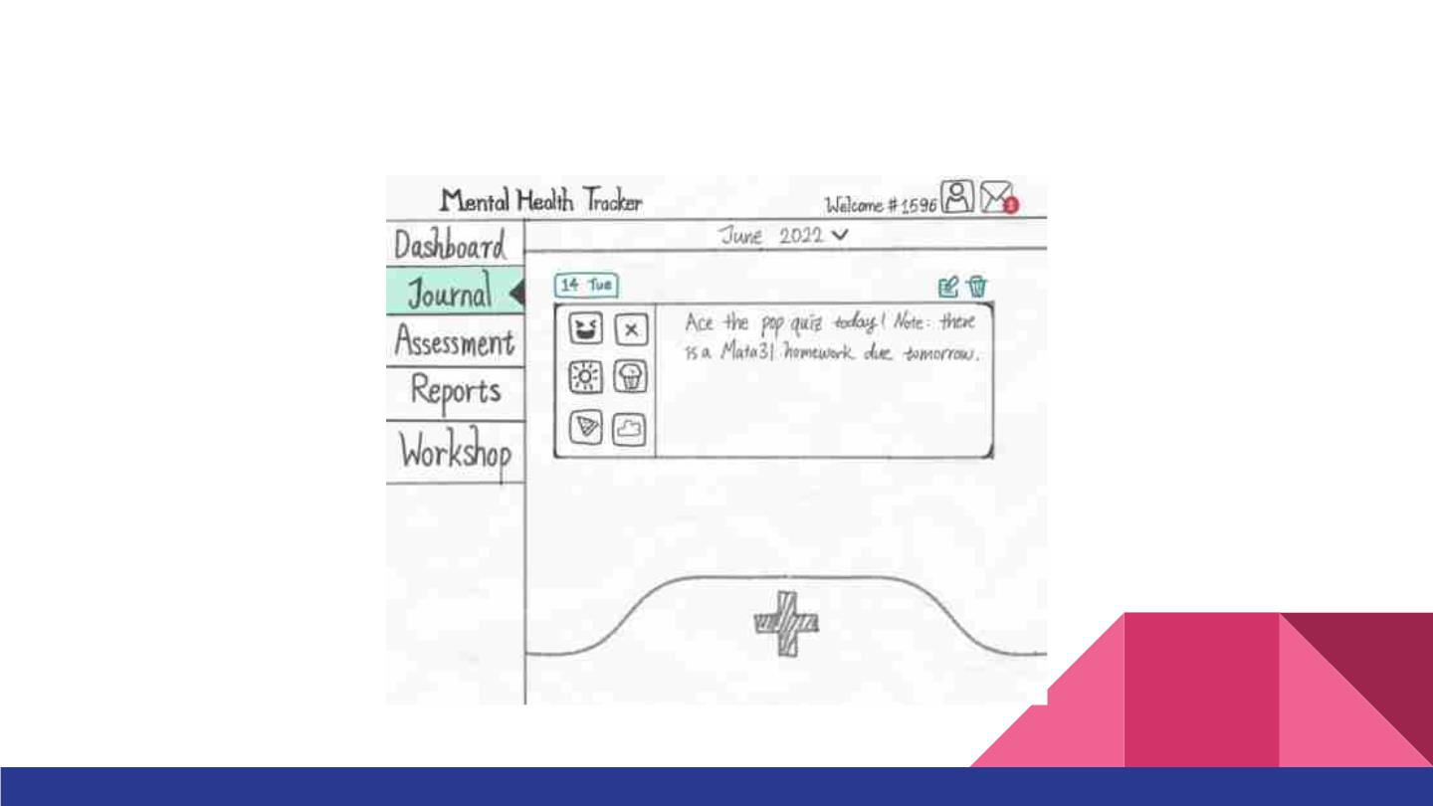
3. You recalled that you accidentally saved an unwanted journal on May 6th. How
would you delete it?

Slide 11
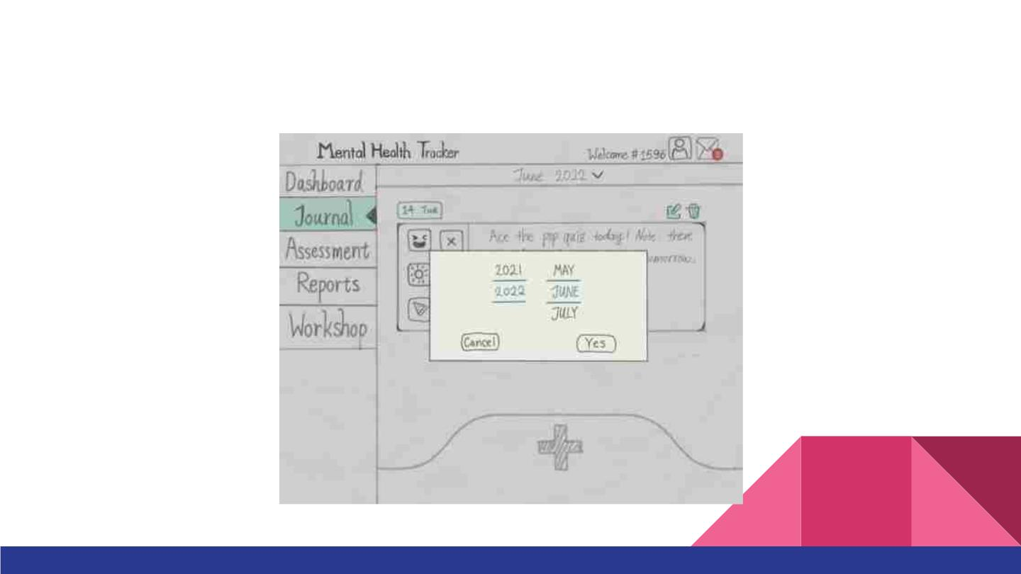
3. You recalled that you accidentally saved an unwanted journal on May 6th. How
would you delete it?

Slide 12
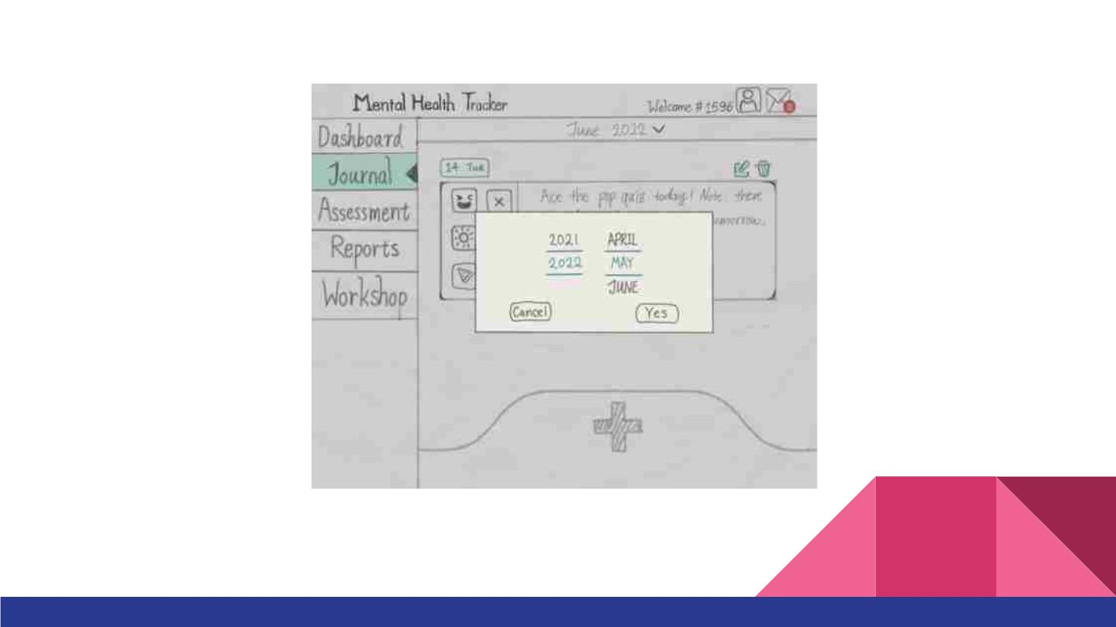

Slide 13
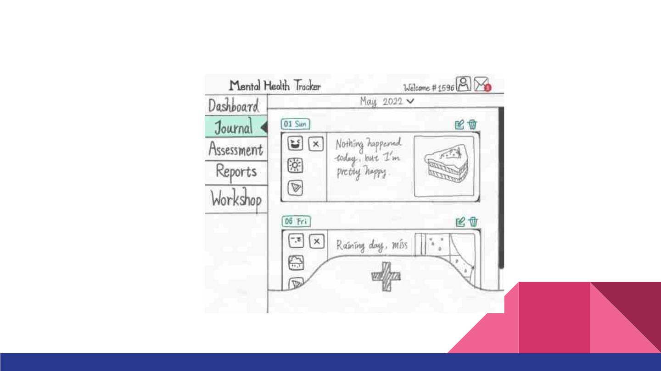
2. You recalled that you accidentally saved an unwanted journal on May 6th. How
would you delete it?

Slide 14
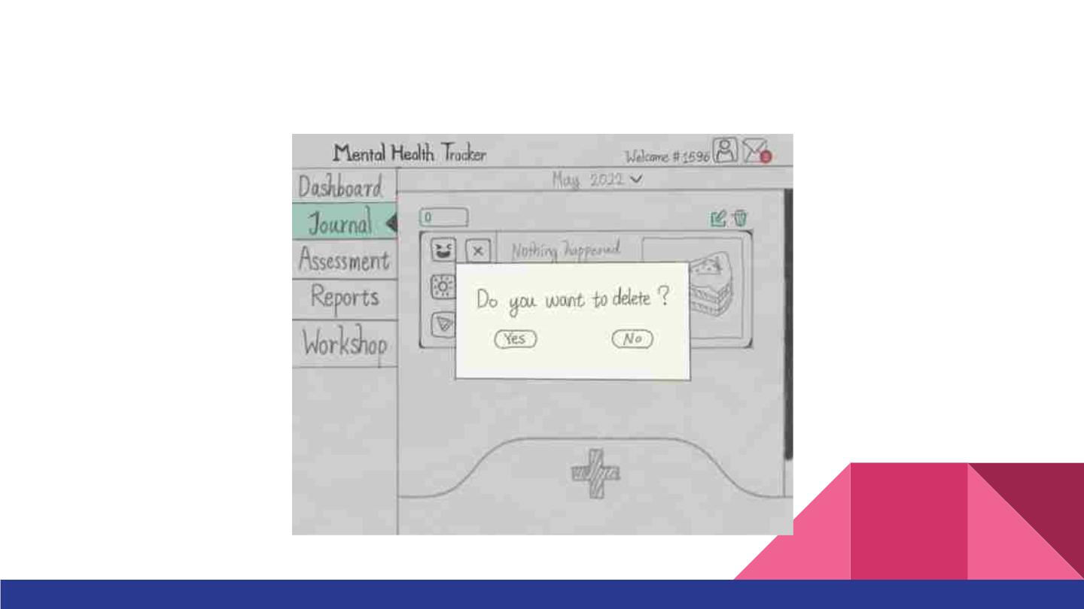
2. You recalled that you accidentally saved an unwanted journal on May 6th. How
would you delete it?

Slide 15
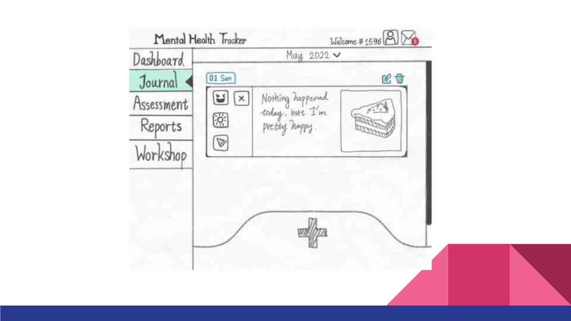

Slide 16
Periodic Mental Health Assessment Scenario
“You are a 1st-year statistics student with mental health challenges. You are
receiving minimal support. You saw the poster for this website on the school
bulletin board, and you think the website would help you better understand
yourself. You decide to try it.”

Slide 17
1. Option 1: You received a
notice in your website
mailbox, and it’s time to
do your periodic mental
health quiz. How would
you proceed using this
website?
Option 2: You want to do
an additional periodic
mental health quiz. How
would you proceed using
this website?

Slide 18
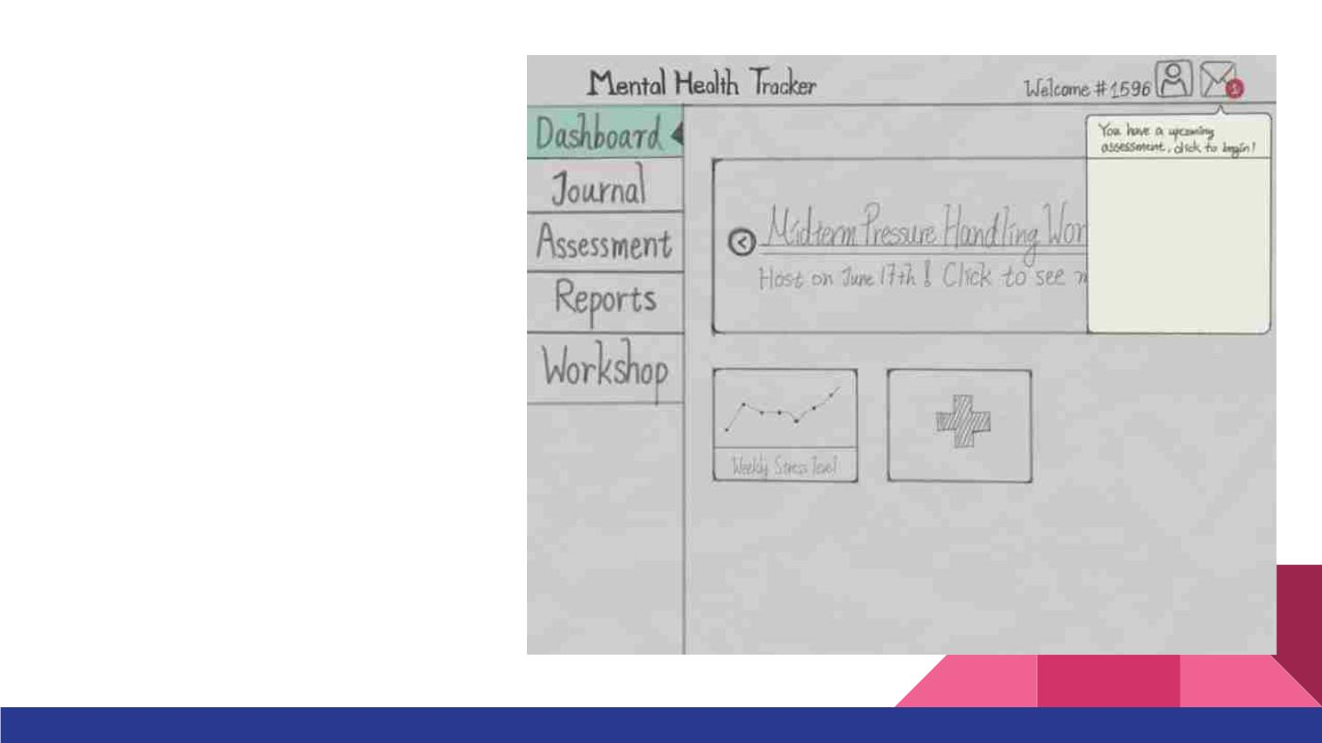
1. Option 1: You received a
notice in your website
mailbox, and it’s time to
do your periodic mental
health quiz. How would
you proceed using this
website?

Slide 19
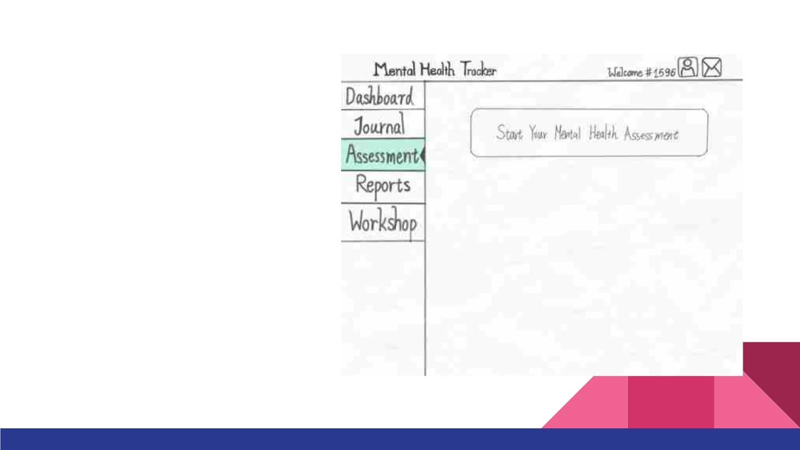
1. Option 1: You received a
notice in your website
mailbox, and it’s time to
do your periodic mental
health quiz. How would
you proceed using this
website?
Option 2: You want to do
an additional periodic
mental health quiz. How
would you proceed using
this website?

Slide 20
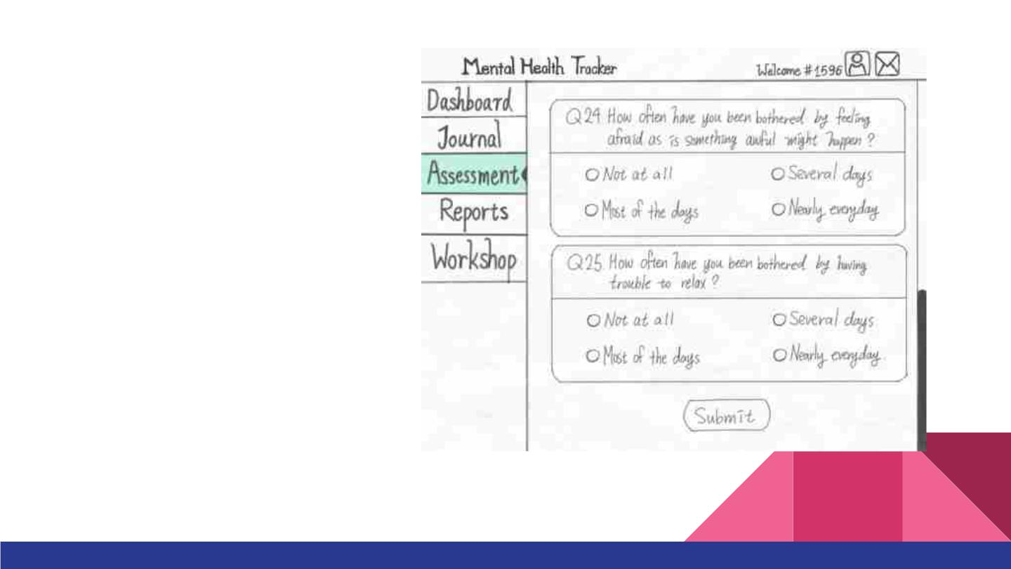
1. Option 1: You received a
notice in your website
mailbox, and it’s time to
do your periodic mental
health quiz. How would
you proceed using this
website?
Option 2: You want to do
an additional periodic
mental health quiz. How
would you proceed using
this website?

Slide 21
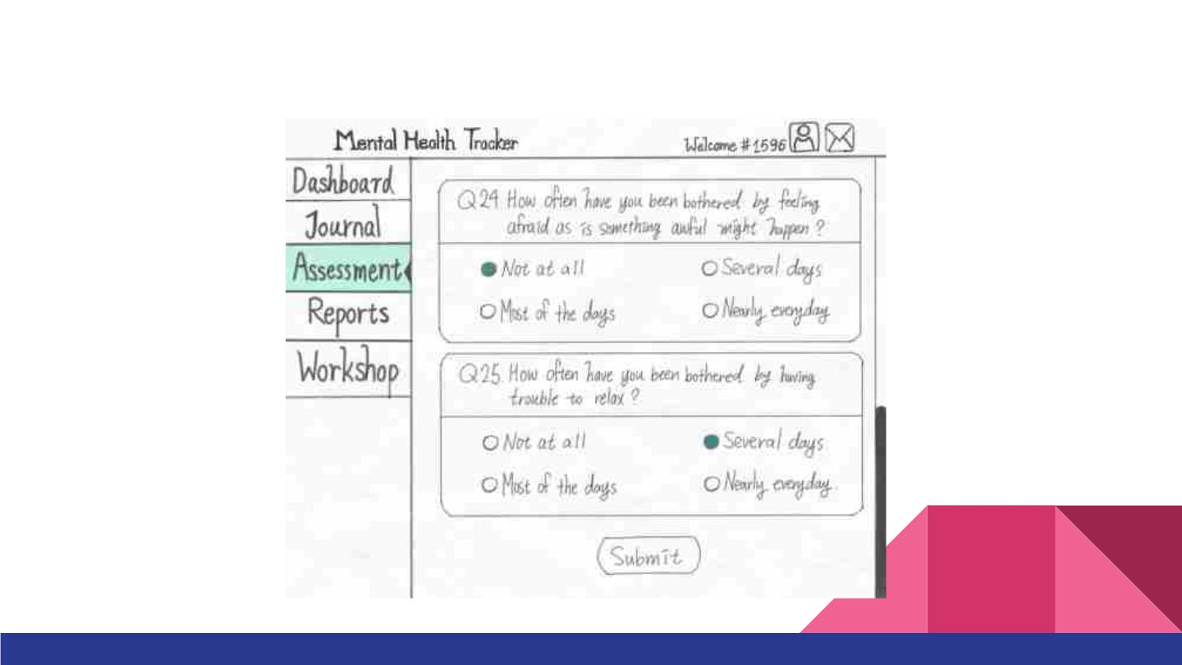
2. You completed the assessment. What would you do to proceed?

Slide 22
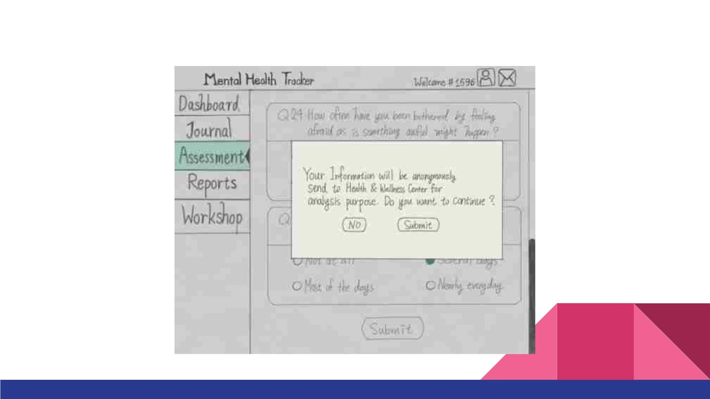
2. You completed the assessment. What would you do to proceed?

Slide 23
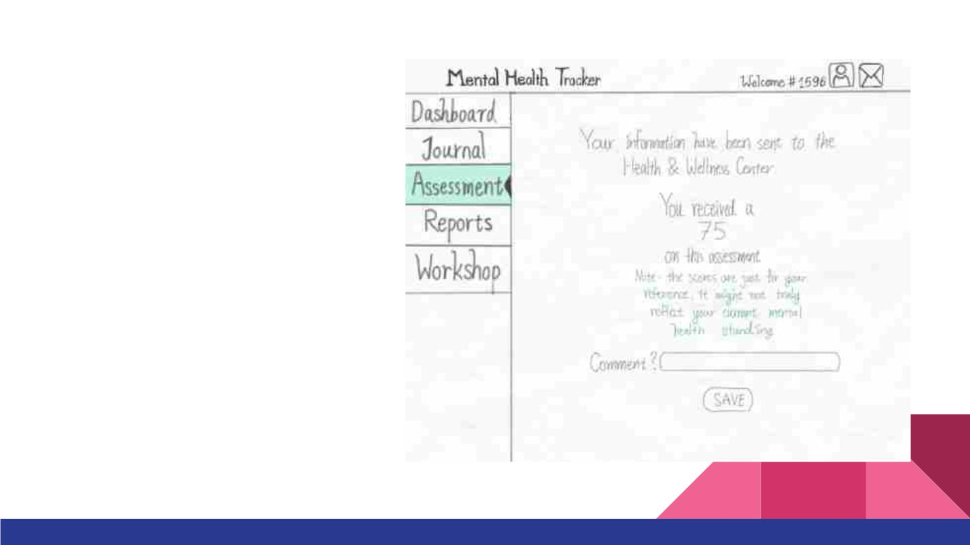
3. You see the score. However
you think the sore is underrated,
you want to leave a note on this
assessment to notify yourself
about that. How would you do
that using this prototype?

